Slide 1
Digital Marketing Campaign
Conversion Prediction
- SUBHAJIT NANDY

Slide 2


Agenda
Problem Statement & Deliverables
Methodology
Data & Folder Section Overview
EDA-Exploratory Data Analysis
Model Development Summary
Stream-lit – Web Page
Deployment
Dashboard Visualizations
Conclusion

Slide 3
Problem Statement
Deliverables
This project aims to enhance campaign effectiveness in the digital marketing sector by accurately predicting customer conversions using historical data and relevant features.
This is a binary classification problem.
The objective is to develop a robust machine learning model that predicts customer conversions based on various demographic and engagement factors, enabling improved campaign targeting, increased conversion rates, and maximized return on advertising spend (ROAS).
A documented machine learning model specifically designed for conversion prediction in digital marketing.
Visualizations of feature distributions, correlations, and model performance metrics.
A comprehensive explanation of the model selection process, feature importance, and data preprocessing steps.

Slide 4
Methodology
In methodology, structured approach is followed.
The project began by cleaning the raw data to ensure accuracy and consistency. After that, after that, conducted Exploratory Data Analysis (EDA) to identify patterns and insights.
Next performed Data Preprocessing to prepare the dataset for modeling.
Then applied a Logistic Regression to predict Conversion Chance and evaluate the model’s Performance using Confusion metrics.
Created Dashboard Visualization to present the findings.
Deployed the app using Streamlit.

Slide 5
Folder Section Overview
Digital Marketing Conversion Prediction
Data
Models
Notebook
Src
digital_marketing_campaign_dataset
digital_marketing_campaign_cleaned
best_model.joblib
decision_tree_best_model.joblib
feature_list
gradient_boosting_best_model.joblib
logistic_regression_best_model.joblib
random_forest_best_model.joblib
svc_best_model.joblib
xgboost_best_model.joblib
Digi_marketing_clean_data
Digi_marketing_preprocessing
Digi_marketing_Training
EDA_Digi_Marketing
__init__
config
Data - a. digital_marketing_campaign_dataset.csv
b. digital_marketing_campaign_cleaned.csv
Models –
best_model.joblib
decision_tree_best_model.joblib
Feature_list
gradient boosting best model.joblib
logistic_regression_best_model. joblib
random_forest_best_model. joblib
svc_best_model.joblib
Xg_boost best model.joblib
Notebook –
a. Digi_marketing_clean_data.ipynb
b. Digi_marketing_preprocessing.ipynb
c. Digi_marketing Training.ipynb
d. EDA Digi Marketing.ipynb
src –
1. init.py
2. config.py

Slide 6
Digital Marketing Conversion Prediction - Overview
Introduction & Objectives
Goal: Predict customer conversions to optimize campaigns
Objectives:
Improve targeting
Reduce wasted ad spend
Enhance campaign performance
Preprocessing & EDA
Notebooks used:
Digi marketing clean data
Digi marketing preprocessing
EDA Digi Marketing
Key steps:
Missing value handling
Feature engineering (categorical encoding, scaling)
Exploratory analysis (distributions, correlations, conversion trends)
Data Overview
Datasets:
digital_marketing_campaign_dataset (raw)
digital_marketing_campaign_cleaned (processed)
Features: demographics, engagement metrics, campaign attributes
Records
Model Development
Models trained:
Logistic Regression
Decision Tree
Random Forest
Gradient Boosting
XGBoost
SVC
Artifacts: .joblib files for each model
Best model: best_model.joblib (selected after evaluation)

Slide 7
Digital Marketing Conversion Prediction - Overview
Model Selection & Evaluation
Metrics compared: Accuracy, Precision, Recall, F1-score, ROC-AUC
Visualization: Confusion matrix, ROC curve
Final choice rationale: [insert best-performing model]
Deliverables
Documented ML model for conversion prediction
Visualizations: feature distributions, correlations, performance metrics
Explanation of methodology, preprocessing, and model selection
Feature Importance
Feature list extracted from model
Top op predictors: [insert key features like engagement score, age, campaign type]
Visualization: Bar chart or SHAP values
Business Impact
Improved targeting → Higher conversion rates
Cost optimization → Reduced wasted ad spend
Enhanced campaign performance → Better ROAS
Conclusion & Next Steps
Summary of findings
Deployment roadmap (cloud/BI integration)
Future enhancements:
Real-time prediction
Personalized campaign recommendations

Slide 8
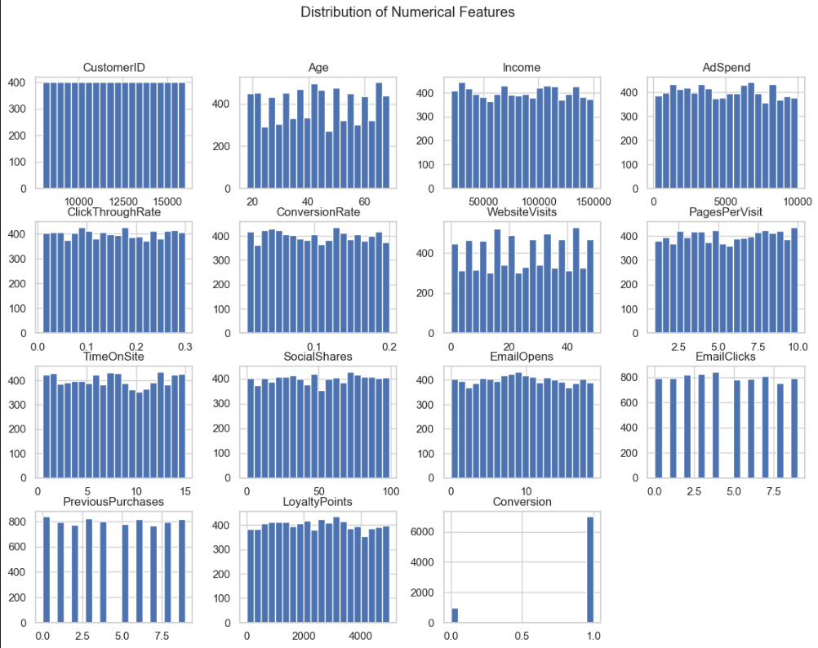
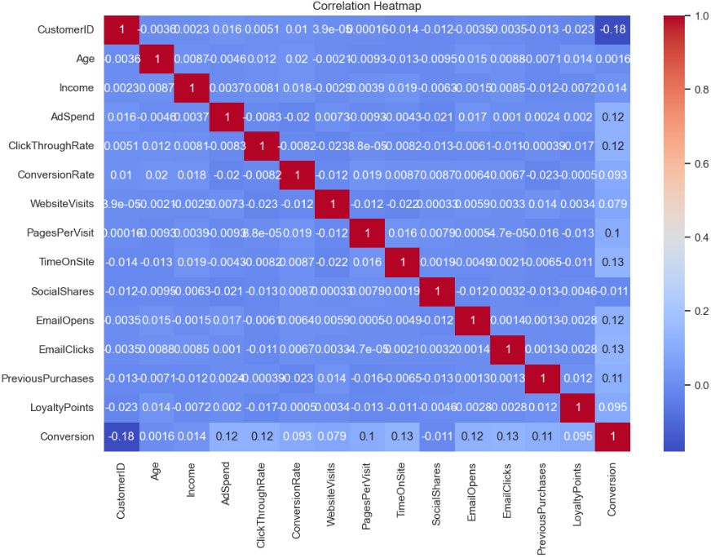
EDA-Exploratory Data Analysis
EDA is used in our prediction model to uncover patterns, detect anomalies, and guide preprocessing and model selection—making the entire pipeline more accurate and interpretable.
Understanding Data Structure
Reveals the distribution of key features like age, engagement score, campaign type, etc. Helps Identify imbalanced classes (converters and non-converters
Detecting Anomalies & Missing Values
Flags outliers that may distort model learning
Highlights missing or inconsistent data
Feature Relationships
Visualizes correlations between variables).
Improving Model Interpretability
Improving model interpretability means making machine learning models easier to understand, to see why a model made a particular prediction and how its decisions are influenced by the data
Guiding Preprocessing
Informs encoding strategies (e.g., one-hot vs label encoding).

Slide 9
Model Development Summary
🧠 Model | 🔍 Icon | 💡 Why It’s Used in the project
Logistic Regression | 📈 | Simple, interpretable baseline for binary classification. Good for understanding feature impact.
Decision Tree | 🌳 | Easy to visualize and explain. Captures non-linear relationships and handles categorical data well.
Random Forest | 🌲🌲 | Ensemble of decision trees. Reduces overfitting and improves accuracy through averaging.
Gradient Boosting | 🚀 | Builds trees sequentially to correct errors. Excellent for handling complex patterns and boosting performance.
XGBoost | ⚡ | Optimized gradient boosting. Fast, regularized, and often top performer in structured data tasks.
SVC (Support Vector Classifier) | 📐 | Effective in high-dimensional spaces. Finds optimal decision boundary using support vectors.
Best Model | 🏆 | Selected after evaluation of all models. Balances accuracy, precision, and interpretability.

Slide 10
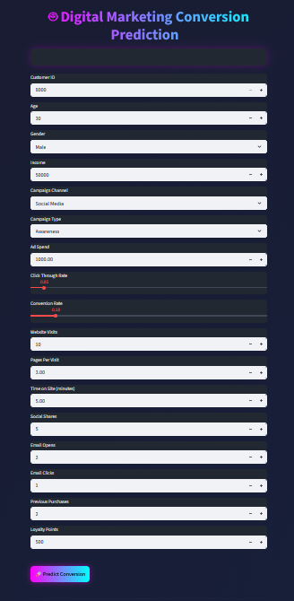

Streamlit – Web Page
Click Here

Slide 11
Deployment
The final xgboost with F1: 0.9639 model was deployed using a Streamlit web application to enable real-time prediction of Conversion Chance.
The application allows users to relevant inputs like Campaign Channels, Campaign Type, Ad_Spend, Website_Visit and customer details and instantly receive conversion predictions.
This deployment makes the model accessible for practical business use and supports operational decision-making.

Slide 12
Dashboard Visualization
A Power BI dashboard is developed to provide an interactive view of conversion chances and key operational metrics for the Digital Marketing Conversion prediction project. The dashboard enables quick monitoring of the following:
Campaign Channel,
Campaign type,
Ad Spend
Customer Behavior like:
Pages Per Visit
Website visit
Time on Site
Social Shares
Email Clicks
Email Opens
Previous Purchase
Loyalty Points

Slide 13
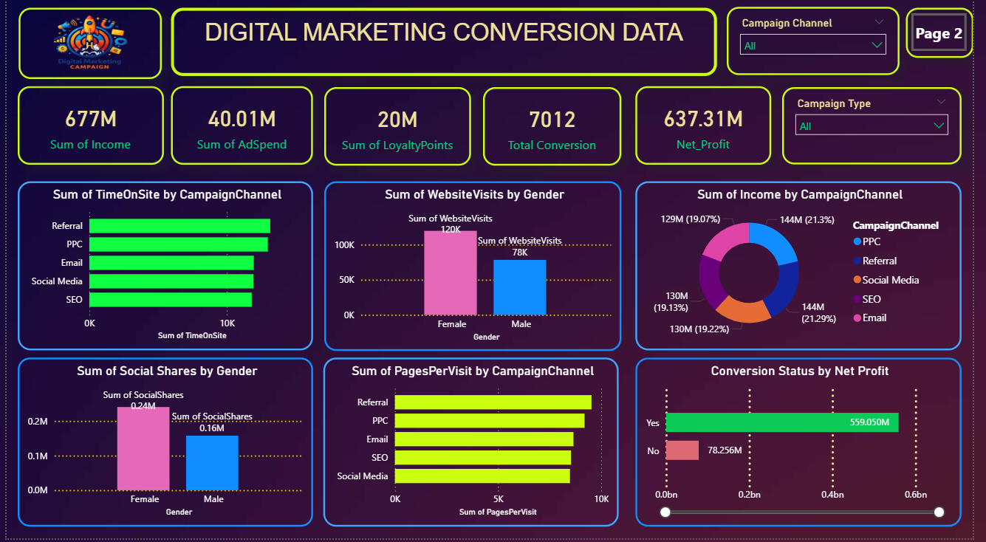
Power BI Presentation

Slide 14
Conclusion
This project successfully predicts conversion likelihood for Digital Marketing using machine learning and data visualization. Multiple models is evaluated, with xgboost with F1: 0.9639 achieving the best performance.
The Conversion Chance rates are highlighted as follows:
>= 40% “✅ Customer is **LIKELY to convert”
>= 30% “⚠️ Customer **MAY convert** (Needs nurturing”
< 30% “❌ Customer is **UNLIKELY to convert**”
The Power BI dashboard and Streamlit deployment transformed model outputs into actionable insights, enabling to develop a robust machine learning model that predicts customer conversions based on various demographic and engagement factors, enabling improved campaign targeting, increased conversion rates, and maximized return on advertising spend (ROAS).

Slide 15

Questions ?

Slide 16
Thank You!

